Slide 1
Job Hub Connect: Revolutionizing Job Search
~ Your Gateway to Diverse Opportunities
Group 9 - Alpha
Sainithin Damaragidda
Pavan Kalyan Kudidala
Uday Kalyan Nuthalapati
Vishal Miyapuram
Abhishek Kotrike
Shravani Kasula
Keerthi Lekkala Dilli
Sai Venkata Nithyananda Reddy Gajjala

Slide 2
Agenda
Introduction
Market Analysis
Solution Overview
User Experience
Tech Stack
Risk Analysis
Project Timeline
Marketing and Growth Strategy
Conclusion

Slide 3
Introduction
Mission : Simplifying the job search process for users by aggregating job listings from various sources into one centralized platform
Objectives
Aggregating job listings from multiple sources
Enhancing user experience through personalized features
Fostering a community driven environment for knowledge sharing and support

Slide 4
Market Analysis
Current job search landscape characterized by fragmented job listings across multiple platforms and portals.
Challenges faced by job seekers:
Time Consuming search process
Difficulty in finding relevant opportunities
Opportunity for a centralized job board platform like JobHub Connect to address these challenges and provide a more efficient solution for job seekers

Slide 5
Solution Overview
Job Hub Connect: A centralized job board platform designed to simplify the job search process.
Features:
Aggregating job listings from various sources into one platform
User Friendly interface for easy browsing and filtering of job listings
Personalized job alerts based on user preferences
Application management tools for tracking job applications
Value proposition: Providing users with a streamlined and efficient platform to explore diverse job opportunities

Slide 6
User Experience
Key elements :
Intuitive Interface:
JobHub Connect prioritizes simplicity with a modern and intuitive interface, ensuring easy navigation for users exploring job listings and profiles.
Personalized Job Alerts:
Stay informed effortlessly with personalized job alerts, receiving real-time notifications tailored to your preferences for relevant opportunities.
Community Engagement:
Foster connections and gain support within our community-focused platform. Engage in discussions, network with professionals, and enhance your career journey.
Goal: Ensuring that users have a positive and seamless experience while using JobHub Connect for their job search

Slide 7
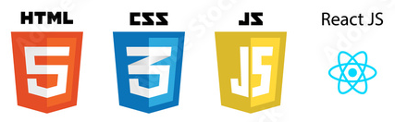
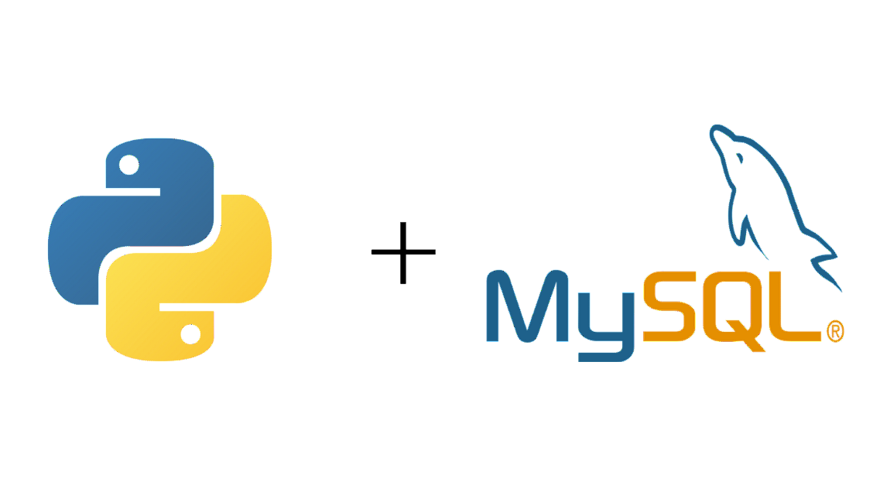


Tech Stack
Frontend
Backend
Deployment

Slide 8
Risk Analysis
Identified Risks:
In our risk analysis, we have pinpointed several key areas of concern:
Data inaccuracies: The risk of incorrect or outdated listings.
Technical issues: Possible challenges related to platform functionality and performance.
Security breaches: The threat of unauthorized access or data breaches.
User engagement challenges: The risk of low user adoption or retention.
Legal compliance issues: Concerns related to regulations and legal requirements.

Slide 9
Risk Analysis
Mitigation Strategies:
To actively address these risks, we have implemented a comprehensive set of mitigation strategies:
Regular monitoring and validation checks: Continual assessment to identify and rectify data inaccuracies promptly.
Rapid response protocols for technical issues: Immediate actions in place to address any technical challenges or downtime.
Robust security measures and regular audits: Stringent security protocols and regular audits to safeguard user data.
User feedback mechanisms: Actively seeking and incorporating user feedback to enhance engagement and satisfaction.
Legal consultations and updates to platform policies: Regular consultations with legal experts to ensure compliance with regulations and timely updates to platform policies.
By proactively identifying these risks and implementing these mitigation strategies, we are confident in our ability to navigate challenges and maintain the integrity and success of JobHub Connect.

Slide 10
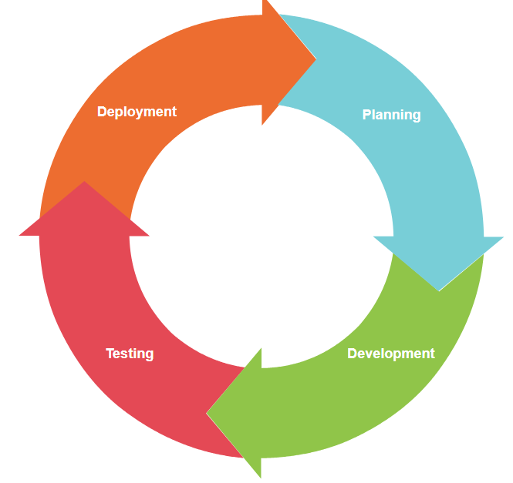
Project Timeline
Phases of the project:
Planning: Defining project scope, requirements gathering
01
Development: Building and testing the platform features
02
Testing: Quality assurance and user testing
03
Deployment: Launching the platform and ongoing maintenance
04

Slide 11
Marketing and Growth Strategy
Target Audience: Job seekers seeking diverse employment opportunities.
Marketing Channels:
Social Media: Targeted advertising and community engagement.
Email Campaigns: Reaching potential users and employers.
Partnerships: Collaborations with job portals and recruitment agencies.
Growth Strategy:
User Acquisition: Targeted marketing campaigns and promotional offers.
User Retention: Personalized features and ongoing engagement.
Community Building: Networking events and knowledge-sharing initiatives.

Slide 12
Conclusion
Job Hub Connect revolutionizes the job search process, providing users with a streamlined and efficient platform.
In closing, JobHub Connect stands as a transformative force in the realm of job searches. It aspires to be more than just a platform — it's a catalyst for a seamless, efficient, and user-centric job hunting experience. Throughout this presentation, we've explored the core facets of our project, from its foundational objectives to the technical intricacies, potential challenges, and our vision for sustainable growth. Join us on this journey, experience the difference, and be a part of JobHub Connect's commitment to continuous improvement. Your feedback is not just welcomed; it's integral to our mission. Thank you for your attention, and we look forward to revolutionizing the way you approach your job search with JobHub Connect."

Slide 13
Thank You!!
Group 9 - Alpha

